Slide 1

BOX OFFICE REGESSION
Ananya Chaudhari & Joseph Gaffney

Slide 2

Our data
Dependent Variable
Overall Box Office Earnings
Independent Variables
*Movie Budget , *Gender of Lead Actor, *Box Office Opening Weekend Earnings , *Number of Oscars Won, Age, Runtime, Critical Review Scores, Audience Review Scores
Other Parameters
Movies released post 2008 which marked the end of the HD DVD Promotion Group, so studios predominately relied on box office sales for revenue
All monetary values were adjusted for inflation
On average, films chosen were high grossing films
(Lowest Grossing = 46 M, Highest Grossing = 4,099 M)
Do female or male led movies perform better at the box office?

Slide 3

Research
Multiple studies that have analyzed high grossing box office movies in the 21st century have found movies with female leads and co-leads gross higher than movies with leads and co-leads
This was particularly true for romantic comedies and dramas
An analysis of the top 100 grossing movies found that films directed by women had higher box office returns than those directed by men
One study found a higher percentage of female cast members had a positive effect on box office performance, particularly for films with smaller budgets
Another study found that male directors and male leads tended to have higher box office returns than those with female directors and female leads, also found films with smaller budgets' box office results are less affected by gender
Overall Consensus: Movies with female leads and co-leads tend to preform better in the box office, but when it comes to movies with smaller budgets gender is less significant

Slide 4
DESCRIPTIVE STatistics

Slide 5
(+) Movie Budget
a higher budget is generally associated with higher production values, marketing efforts, and star power
(+) Gender of Lead Actor
based on our research we anticipated that female lead actors would have higher grossing box office films
(+) Box Office Opening Weekend Earnings
this variable represents the initial hype and interest generated by the movie which would likely result in high box office earnings
(+) Number of Oscars Won
this variable reflects critical acclaim and recognition which can increase the appeal of the movie to audiences
Expected signs

Slide 6
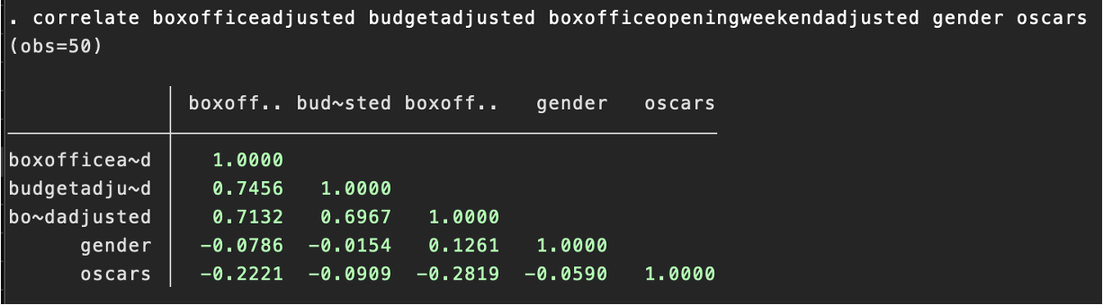
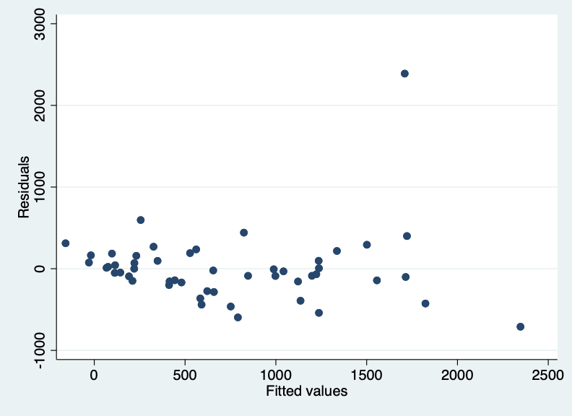
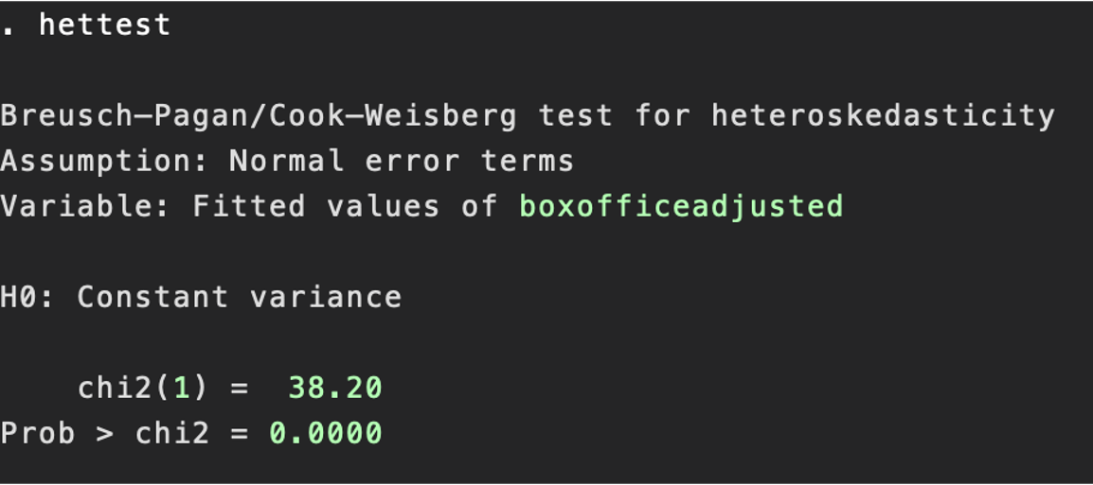
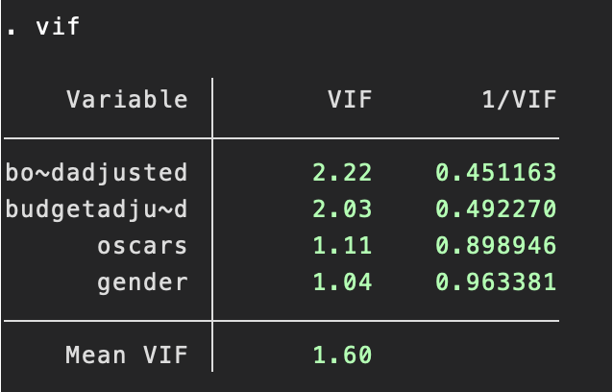
Pearson Correlation Coefficient Matrix
The residual values show signs of heteroskedasticity
Breusch-Pagan Test: Since the Prob > chi2 value is less than 0.05, we can reject the null hypothesis and conclude there is heteroskedasticity present in the dataset
VIF: No signs of multicollinearity

Slide 7

Regression Results

Slide 8
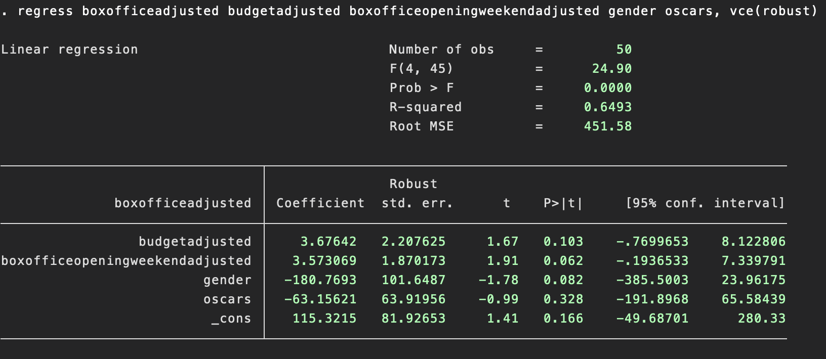

Final Regression

Slide 9
Box Office Sales = $115 + $3.68(Budget) + $3.57(Opening Weekend) - $181(Gender) - $63(Oscars) &
Equation
*in millions of $ **Gender: Female = 1, Male = 0

Slide 10
KEY Take aways
1. The budget and box office opening weekend sales have positive coefficients (expected sign), and the p-values, though not SS, they are within the 90% confidence interval.
The gender of a lead actor has a negative effect on box office sales if the actor is a female, as indicated by its negative coefficient. Although unexpected, it was still included in the regression due to its perceived importance. Again, the p-value falls within the 90% confidence interval.
Finally, the number of Oscars the lead actor has does not appear to be a significant variable of box office sales, as it has a negative coefficient and a non-significant p-value.
Notes:
However, if the purpose is to build a comprehensive model that includes all potentially relevant variables, then it may be appropriate to keep the variable in the model. Additionally, it is possible that the lack of significance is due to the sample size or other limitations in the data, and dropping the variable could lead to biased or incomplete results.
In summary, the decision to drop a variable from a regression model should be based on the purpose and context of the analysis, and should be carefully considered before making any changes.

Slide 11
Key Take aways
2. The adjusted R-square value of 0.63 indicates that the model explains 63% of the variance in box office sales. This means that the model has moderate explanatory power.
3. The Root Mean Squared Error (RMSE) of 451.58 indicates that the model's predictions deviate from the actual box office sales by an average of $451.58 million. This value may seem high, but it is important to consider the scale of the dependent variable (Lowest Grossing = 46 M, Highest Grossing = 4099 M).
Overall, this is a moderate model that provides some insight into the factors that may influence box office sales. However, there may be other variables that could improve the model's accuracy

Slide 12
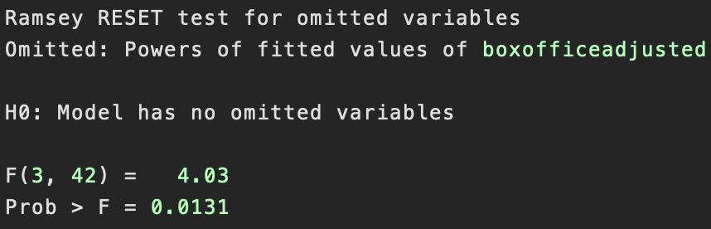
Since the p-value is less than .05, we reject Ho and conclude that there are omitted variables Potential Omitted Variables % Genre Type Original or Adapted Screenplay Number of Movies in Theaters at time of Release Reputation of Director/Crew Sequel or in a Franchise
OVTest
Limitations

Slide 13

FORECASTING 2023 BOX office SALES

Slide 14


The Little Mermaid $878,940,000 & Barbie $692,320,000

Slide 15


Oppenheimer $816,000,000 & Dune: Part Two $898,120,000

Slide 16
Concluding Thoughts
Although our research found female lead or co-lead movies performed better at the box office — which can be attributed to diversity, innovation, the ability to appeal to wider audiences — our selected data showed male films to be higher grossing.

Slide 17
References
Dickey, S., & Picard, R. G. (2019). The impact of gender diversity on box office performance: Evidence from 2017. Journal of Business Research, 98, 118-126.
Johnson, M. R., & Woodcock, J. (2016). Female leads and box office success: A historical analysis of Hollywood's top 100 films. Journal of Broadcasting & Electronic Media, 60(2), 299-316.
Kim, S. Y., & Kim, K. H. (2018). Does gender diversity of cast and crew matter? Evidence from box office performance. Journal of Business Research, 91, 94-101.
Kolesnikova, A., Brown, J., & Kolesnikov, S. (2021). Gender representation in the top-grossing films of 2019: An intersectional analysis. Journal of Feminist Scholarship, 16(1), 1-20.
Krause, A., & Langbein, L. (2018). Gender inequality in the film industry: Evidence from a century of films. Journal of Cultural Economics, 42(1), 105-140.
Smith, S. L., Choueiti, M., & Pieper, K. (2015). Inequality in 700 Popular Films: Examining Portrayals of Gender, Race/Ethnicity, LGBT & Disability from 2007 to 2014. Communication Research Reports, 32(2), 149-157.

